Slide 1

Grow with Exilir CAPITALS
Eshaan Kumar
& Abhay Singh

Slide 2

AGENDA
About Elixir Capitals
Investment Options Available
​Why Elixir
Governance
​Business Model

Slide 3
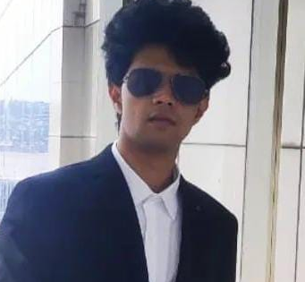
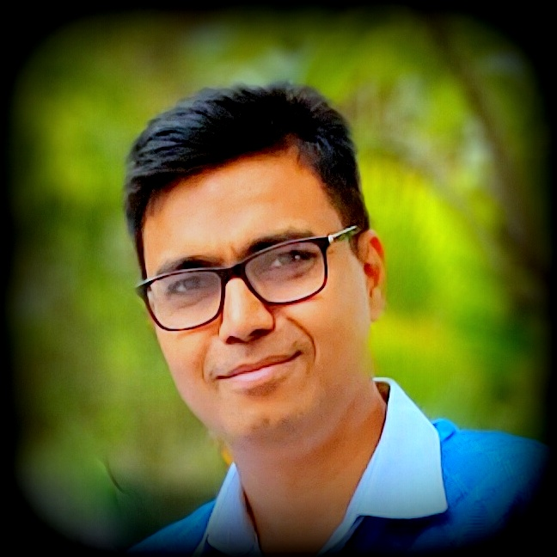
MEET OUR TEAM
Eshaan Kumar
Abhay Singh
Director-Operations
IIT Roorkee
Director-Strategy

Slide 4

ELIXIR’S MISSION
Grow clients’ investments by maximizing profits & manage losses using the best portfolio management strategies

Slide 5






Investment options
Bank Saving: 3% to 6%
Risk: Nil
Property: Up To 15%
Risk: Low
Fixed Deposit: 6% to 9%
Risk: Nil
Mutual Fund: 8% to12%
Risk: Moderate
Our Strategy is 24% to 36% & beyond
Risk-Very Low
Stocks Unlimited Gain
Risk: High

Slide 6

WHY ELIXIR
With the help of an extensive study of the stock market and its various parameters, whilst deploying fundamental, technical, and quantitative analysis, Elixir has developed a strategy to produce consistently high returns at very low risk

Slide 7
WHY ELIXIR - Certificates
NISM-Series-VIII: Equity Derivatives
NISM-Series-V-B: Mutual Fund Foundation
NISM-Series-V-A: Mutual Fund Distributors
NISM-Series-XVIII: Financial Education Certification
NISM-Series-XII: Securities Markets Foundation
NISM-Series-ll-B: Registrars to an Issue and Share Transfer Agents - Mutual Fund
NISM-Series-VII: Securities Operations and Risk Management

Slide 8
WHY ELIXIR-Credentials
Client
Duration
Monthly Gain %
Profit Factor
Strategy
Capitals
Lakhs
Proofs
YWQ563
1 Month
20.05
6.23
Short Credit Spread- EB
7.98
VWH918
15 Days
19.92
Short Credit Spread- EB
10.00
5074
10 Days
12.8
Short Credit Spread- EB
7.45
Upstox Client
1 Month
13.93
5.21
Short Credit Spread- EB
7.45
5516
5 Month
141.00
>100
Naked Buying Option
0.25
Sanjay-US
3 Month
5.15
BTST in small and Mid Cap
12.85
Lawyer
1 Month
10.97
Hedge Option Buying
10.00

Slide 9

Governance
We will be using the client’s Demat account for giving complete transparency and minimal tax liability
Elixir will be settling accounts/ submitting fee bills on a Quarterly basis
Elixir will be available for query resolution & customer support at all appropriate times
All customer data and investment details are confidential
The strategy utilized by Elixir Capitals will remain CONFIDENTIAL as well as the sole right and property of the organization

Slide 10

Business Model
PROFIT SHARING
Client’s Earnings
Mutual Fund
Hedging
Earning from Mutual Funds will 100% pass on to client
50% of Earning from Hedging will be pass on to client
Rest 50% will be Elixir Fees
Ex Client Gain 20% Annually from Mutual Fund and 2% monthly from Hedging - Client will Get= 20% Annually & 1% monthly
Elixir will receive = 1% monthly
Settlement
Elixir will submit Quarterly bills for Elixir’s profit share
Exit Load
If the client wishes to withdraw the capital [partially or fully] before 3 months, then 1% of the amount withdrawn will be charged
Notice Period & Management Fees
The client needs to provide a notice period of a minimum of 1 week
0.02% Monthly Maintenance Fees will be applicable on AUM

Slide 11
THANK YOU
Abhay Singh
abhayk007@gmail.com

